Slide 1
Addressing the paradigm shift Methodological investment priorities for the medium term
Emanuele Baldacci
Director of Resources, CIO, Eurostat – European Commission
Journées de méthodologie statistique (JMS) de l'Insee, 29-31 mars 2022 – Horizon 2027
Notes:
Abstract for the presentation
Addressing the paradigm shift : Methodological investment priorities for the medium term
Emanuele Baldacci
Director Eurostat - Dir A Resources - CIO
The aim of the presentation is to identify and discuss the key methodological challenges for the next 5 years putting the focus where ESS collaboration is needed.
The presentation will start recalling the context in which methodological innovation will take place in the ESS in particular the setting up of an ESS innovation agenda. This initiative launched by the ESSC aims at streamlining and accelerating innovation carried out by various actors in ESS. This innovation should address the most pressing business needs i.e gaining in efficiency to free resources to innovate in new statistical products to cover and deepen our understanding of new phenomena taking benefit of new technologies and advanced methods.
The presentation will point towards few of the key methodological challenges and opportunities ahead for the compilation of the new generation of official statistics in particular those originating from the incorporation of new modes of data collection based on smart devices and the use non-traditional data sources. These innovations would reduce the data collection burden and contribute to the fight against declining survey response rates. They will require new approaches finding innovative ways to engage citizen and businesses to reuse and support the integration of the data produced by their interaction with their digital ecosystem into offical statistics production. These new modes for data collection are enabled because of the power of new algorithms to extract information from unstructured information’s (text, speech, images, device signal… ).
The paradigm change will need to be prepared by upskilling a new generation of official statisticians enabling them to take benefit from the new toolbox that developments in computer science offer to them. It also needs to be accompanied by a significant extension of quality framework to monitor the quality of statistical outputs compiled by combining the many data sources and channels. It also require new modes of organisation to deliver faster and in a more agile way.
The presentation will conclude by opening up for discussion on the need and possible modes to engage broader communities beyond official statisticians and how to scale up to the entire ESS innovations carried out at national level.

Slide 2
Outline
Introduction and context
01
Drivers
02
Priorities for methodological developments
03
Eurostat’s role
04
Collaboration and partnership
05

Slide 3
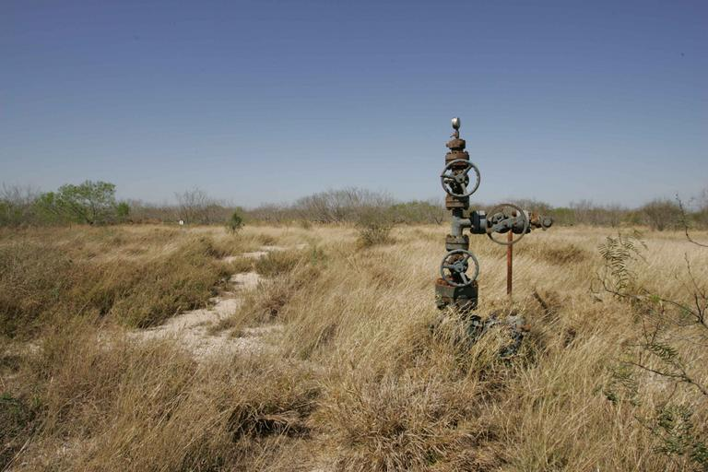
Official Statistics paradigm shift
From a data-scarce world …
where statistical authorities concentrated on collecting data survey/census as primary sources
… to a data-rich world
where statistical authorities should distill reliable information from multiple data sources building on their asset : traditional sources and sounded methodologies (calibration, integration, …)
Notes:
Metaphore :“data is like water”, then “official statistics is like drinking water” (trustworthy) … official statistics is not less important in a data-rich world (in the flood) than it was in the data-scarce world (in the desert)… but the way to provide it changes: from drilling to distilling …
We see the emergence of a new paradigm for compiling official statistics where traditional survey will coexist with processing of non-traditional data sources

Slide 4
Policy Context
The ESS Vision 2020 Programme ended in 2020 delivering a wide range of results
The COVID-19 crisis has proved that innovation is more important than ever in a rapidly changing data ecosystem and to respond to new user needs
A broad consensus on the need to keep a focus on ESS innovation as part of the Multi Annual Plan with a broad scope (product and process innovation)
New measure and new indicators demands …
Health
Inclusive Societies
Security and autonomy
Digital, Industry
Climate, Energy & Mobility
Food, Bioeconomy, Natural Resources, Agriculture & Environment
Notes:
With the positive conclusion on ESS Vision 2020 programme, there was a broad consensus on the need to keep a focus on ESS innovation as part of the MAP with a large scope (product and process innovation)

Slide 5
ESS innovation
ESS innovation agenda
stocktaking existing innovation, priorities, enablers for innovation, funding mechanism, reaching out a large community, maintaining alignment with ESS business goals
Implementation and deployment of innovation actions
Foster cooperation, coherence of portfolio, putting in place enablers for accelerating, and ensuring business outcomes/ concrete realizations, communicating and promoting,

Slide 6
EU data economy
Business
B2G / G2B
Government
C2G / G2C
Citizen
C2B
Data Governance Act
High-Value Datasets
Data Act
25 Nov 2020
2nd Quarter 2022
Proposal released on 23 Feb 2022
GDPR
ePrivacy
Digital Services
…
Official Statistics
Notes:
The European Data strategy is being implemented through a number of legislative initiatives. I would like to refer to three such initiatives of major importance:
Firstly, the Data Governance Act, that aims at providing an overarching governance framework for the establishment and functioning of common European Data Spaces, e.g. a European health data space that will among others promote safe exchange of patients’ data and citizens’ control over their data, support research on treatments and medicines, or a European Green Deal data space.
Secondly, the implementing regulation on High-Value Datasets that include a list of datasets, inter-alia official statistics, with a high commercial potential that can speed up the emergence of value-added EU-wide information products.
(Value Datasets (HVDs): • Geospatial • Earth observation and environment • Meteorological • Statistics • Companies and company ownership • Mobility
Thirdly, I would like to mention the forthcoming Data Act that aims at supporting business-to-business data sharing and enabling access to data held by private sector entities, when these data are of public interest

Slide 7
DIGITAL EUROPE - GovTech
Digitalization of the public sector
Services to public go digital
Public sector interoperability
Digital transformation of industry, services and public sector driven by AI
Engage with start-ups and SMEs to procure innovative technology solutions

Slide 8
Drivers for methodological innovation
Input
Faster and timelier delivery
Quality
Measuring and maintaining quality
Quality
Ouput
Leaner, more automated and more robust processes / more composable / more resilient to shock (pandemy)
New personas for data providers and data users
Product innovation (adaptive, tailorable, inclusive)
Faster and timiler
Processes
Partnerships and Open Innovation
Culture and People
Declining participation to traditional data collection mode
Integration of non-traditional data sources
Data sources
Notes:
Drivers for methodological innovations
Declining participation to traditional data collection mode
New personas for data providers and data users (the youth …)
Faster and timelier delivery
Product innovation (adaptive, tailorable, inclusive)
Integration of non traditional data sources
Maintaining quality (in particular comparability) in the new data ecosystem
Leaner, more automated and more robust processes / more composable / more resilient to shock (pandemy)

Slide 9
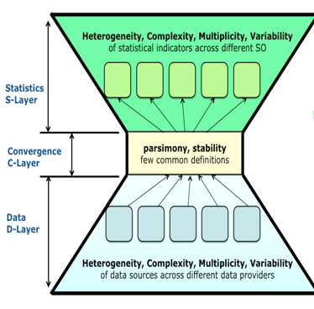
Methodological challenges : (1) input
1. New sources
3. Multi-mode
Information retrieval from unstructured data (image, textual, signal, smart devices, IoT)
Expanding and generalisation of multi mode data collection
2. Data preparation
4. Citizen statistics
Need to rethink our standardisation model (hour glass model)
Need to engage citizen in the design, data gathering, data validation

Slide 10
Methodological challenges : (2) data integration
1. New sources
3. Modeling
5. Combining sources
Calibration of new sources to population
Multi level modelling for integration and bias correction
Combine sources to validate / improve outputs
2. Automation
4. Synthetic micro data
AI powered (semantic) integration
Model based integrated statistical data marts

Slide 11
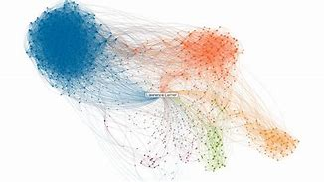
Methodological challenges : (3) outputs
1. Advanced data analytics
3. Experimental statistics
Data insights
Collect user feedback on new/frontier statistics
2. Dynamic visualisation
4. Open algorithms and reproducibility
Tailorable et evolvable products
Fostering engagement and trust

Slide 12
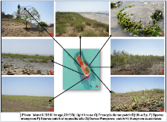
Methodological challenges : (4) quality
1. External sources
3. Reproducibility and
Transparency (OSS)
Interoperable, distributed and accessible metadata
Ability to reproduce and explain results
2. New methods
4. Ground truth
New quality metrics
Annotated data to train and benchmark ML algorithms

Slide 13
New technologies – new infrastructure
New methods/algorithms applied directly on the raw data
Privately Held Data
NSI Cloud
Infrastructure
Smart Device
Privacy preservation protocols, composable and distributed processes

Slide 14
Eurostat roles
Economies of scale
CULTURE
Sharing sources
LEADERSHIP
Funding
Partneship & Alliances
Agile and responsive
Enabling
legal framework
Training
Tools / platform
Collab places
ESS enablers
Notes:
Keep coordinating / sourcing methodological development along the MAP( <- map analysis)
Create the enablers facilitate methodological innovation
Legal framework participation - legal enablers for emergence a new production paradigm based on new collaboration with data holders, researchers, privacy WatchGuard and citizen (data donation, citizen science)
Support the setting up priorities for innovation (PG TF)
Rebuilt cooperation with external stakeholders (academia, researchers, private sectors) through new model of cooperation ( grant, hackathon)
Continuous training / uplift skills statisticians
Reenergising and finding new mode of cooperation among NSIs - more on co creation based on open source paradigm and continuous integration, data campus befitting for new mode of collaboration and proven methods of working
Providing infrastructure/playground at scale (through replication or as a shared instrance)
Enhanced security provision / policy for processing sensitive data
Define generic pattern for information architecture enabling new production mode based on data combination - adequate data governance for common data assets (web data,
Keep up with our TSS track towards reusable components enabling deployment/implementation in NSIS context
continuing effort for setting innovative methods for data collection from data subjects (smart survey)
realising PoC of new technologies to support new mode of collection and processing sensitive data processing (PET)
contributing to the collection of meso data where source are transnational and can benefit the whole ESS on the model of WIH
visualisation and integration capabilities based on GIS capabilities
semantic technologies to make our metadata more used and more active in process (fuelled by AI)
deployment of AI methods in production in MS (automated classification, federation of model training capabilities, repositories of ground truth data)
research on integration of non traditional data sources and related quality issues for statistics compiled from them
research on SDC (new paradigm for output privacy)
digitalisation and automation of Eurostat processes

Slide 15
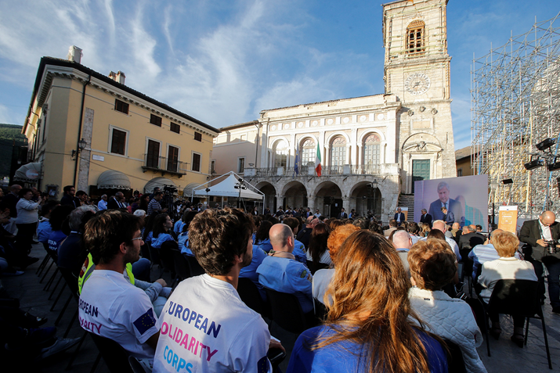
New partnerships – new forms of collaboration
International organisations
Challenges & prizes
Hackathon
Piloting
Research grants
Ecosystem building (innovation labs)
Academics
Citizens’ Engagement
Private sector

Slide 16
Thank you
© European Union 2020
Unless otherwise noted the reuse of this presentation is authorised under the CC BY 4.0 license. For any use or reproduction of elements that are not owned by the EU, permission may need to be sought directly from the respective right holders.
Slide xx: element concerned, source: e.g. Fotolia.com; Slide xx: element concerned, source: e.g. iStock.com

